Slide 1







SUPERVISED LEARNING PREDICTING ACCIDENT SEVERITY
Presented by Group 4

Slide 2


TEAM
Sunehildeep, Singh
Garv, Chhokra
Kugavathanan, Yohanathan
Ariya Agnihothri, Mini Suresh
Rasheed, Adeyemi

Slide 3


Project Overview
This project entails the creation of a predictive model for assessing the probability of fatal collisions, leveraging specific input features. It encompasses comprehensive data exploration, meticulous model construction, and subsequent deployment as a web API. The initiative aims to enhance public safety awareness and facilitate informed decision-making by law enforcement agencies and community members alike.

Slide 4





RESEARCH METHODOLOGY
1st
2nd
3rd
Pre-processing - Retrieve & prepare the data
Model building & fine tuning
Model deployment

Slide 5
DATA OVERVIEW
1.
3.
Data Source: KSI.csv
Value Replacement: Transforming Yes/No to 1/0.
2.
PowerBI: Further exploration with visualization.
Exploration: Missing values, unnecessary columns removed
4.

Slide 6
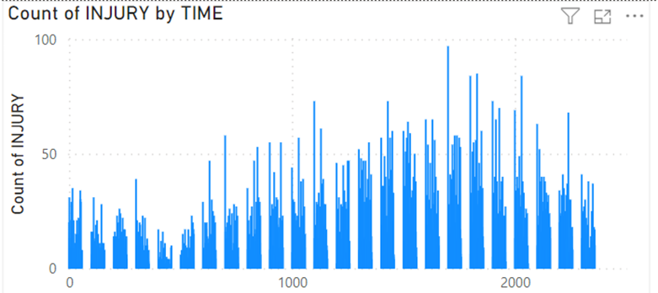
DATA EXPLORATION -1

Slide 7
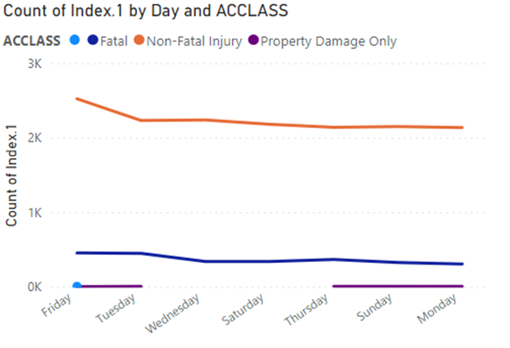
DATA EXPLORATION -2

Slide 8
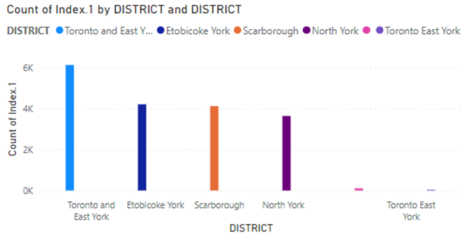
DATA EXPLORATION -3

Slide 9
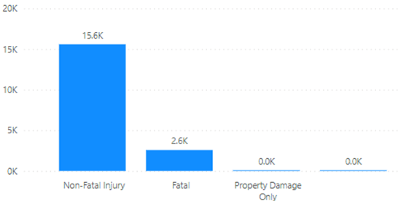
DATA EXPLORATION -4

Slide 10
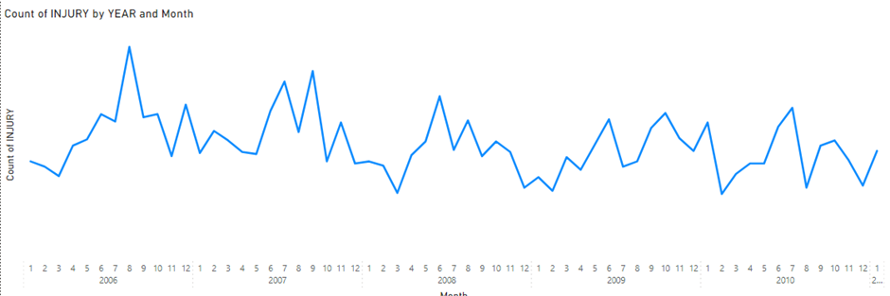
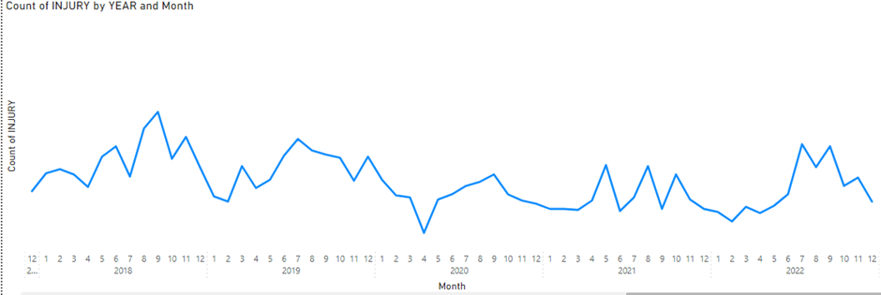
DATA EXPLORATION -5

Slide 11
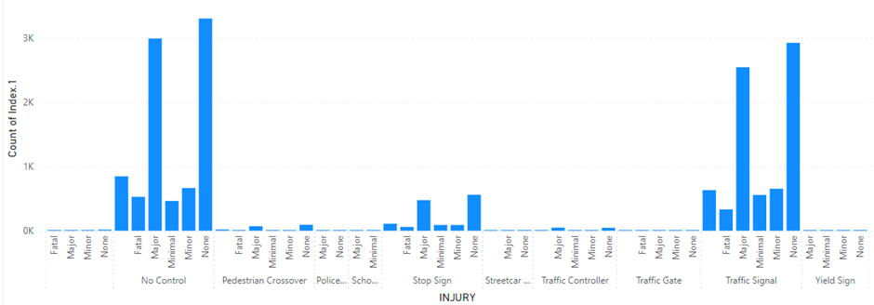
DATA EXPLORATION -6

Slide 12

Data Transformation &Feature Engineering
Transformations
DRIVCOND, DRIVACT, ACCLASS, and more.
Purpose
Enhance data quality and relevance for modeling.
New Features
ABNORMAL, PROPER_DRIVING, ROAD_CLASS, etc
Significance
Better capturing of driving behavior, road types, etc.
Derivation
Categorizing driving conditions, actions, and road types.
Impact
Enriching dataset for improved model understanding.
Improved Predict
Enhanced model performance.

Slide 13

PROCESS
Data Splitting : Stratified Split 80% Train, 20% Test.
Pipeline Construction :
Numerical Transformer: Impute missing values using simple imputer with mean, scale features.
Categorical Transformer:Impute missing values using simple imputer with most frequent, One Hot Encoder.
Preprocessing : Pass both transformers in a ColumnTransformer.

Slide 14
FEATURE SELECTION
Feature Importance: Identify influential features.
We have used Variance Threshold to remove the features
SelectKBest: Utilizing this transformer with ChiSquare to get the best 10 features

Slide 15
WHY WE SELECTED K = 10
Calculated Accuracy Score using Random Forest
Using Different values of K (Best Features)
Selected the number of features using best score

Slide 16
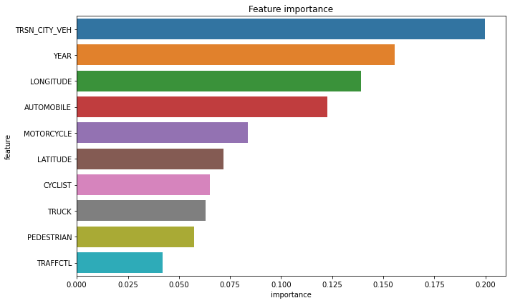
TOP 10 BEST FEATURES WITH THEIR IMPORTANCE

Slide 17
TRAINING THE CLASSIFIERS
We have selected these 5 classifiers to train :-
XGBClassifier
SVM
DecisionTreeClassifier
RandomForestClassifier
LogisticRegression

Slide 18
FEATURE SELECTION AND PREPROCESSING
Sliced the X_train and X_test with selected features
Used Preprocessing Pipeline to transform the new selected data.

Slide 19
NOTING DOWN THE RESULTS
After each training loop, we record the following results :-
Training and Testing Accuracy of the best estimator
Confusion Matrix and Classification Report
Cross Validation Mean Score of the best estimator
At the end of observations, we dump the best estimator into a pickle file

Slide 20
WHY RANDOM FOREST
Numerous Reasons of choosing RF as the best model:
High Test Accuracy: 97.53
Balanced Precision and Recall
Low Overfitting

Slide 21
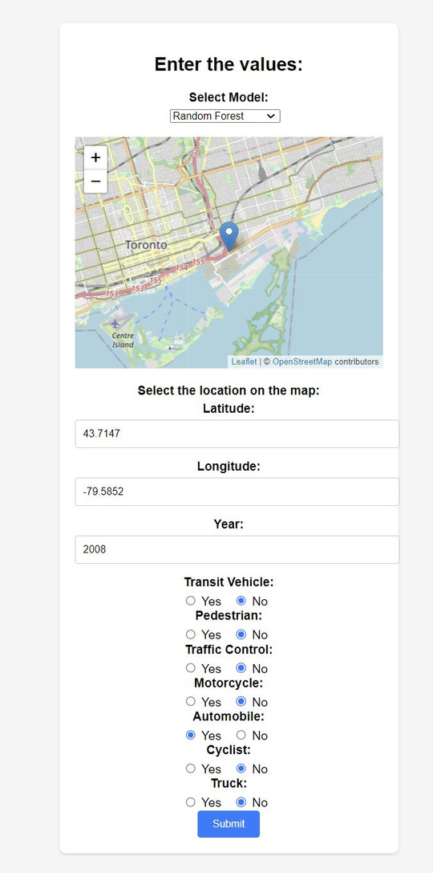

PREDICTING ON THE FRONT-END

Slide 22
THANK YOU
If you have any questions.
Feel free to ask.

